Slide 1


Airline Management System

Slide 2

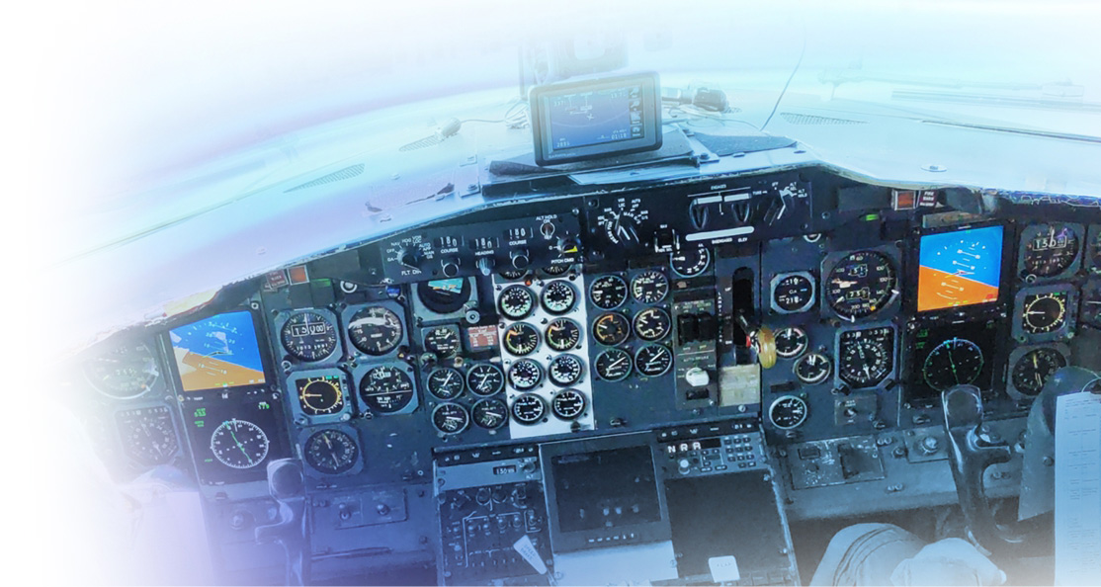

Reason for choosing this topic
Motivation:
Airlines face complex challenges in managing operations.
A smart database is the solution to streamline processes.
Electronic Navigator:
Imagine the database as a digital assistant for airlines.
Ensures smooth flights, organized passenger details, and well-coordinated employee tasks.
Overall Goal:
Elevate airline operations to new levels of efficiency.
Provide insights into the benefits of advanced data solutions in the airline industry.
Specifically designed to tackle airline-related issues.
Focus on efficient management of flights, passengers, and employee assignments.

Slide 3

Core Entities
The KEY entities within the Airline Management System Database.
Cities,
Airports,
Airlines,
Aircraft,
Routes,
Flight_Scheduling,
Flights,
TicketPrices,
Passengers,
BookingDetails,
Employees,
CrewMembers,
Users
These entities cover crucial aspects of airline operations, ensuring a comprehensive and well-organized system.

Slide 4
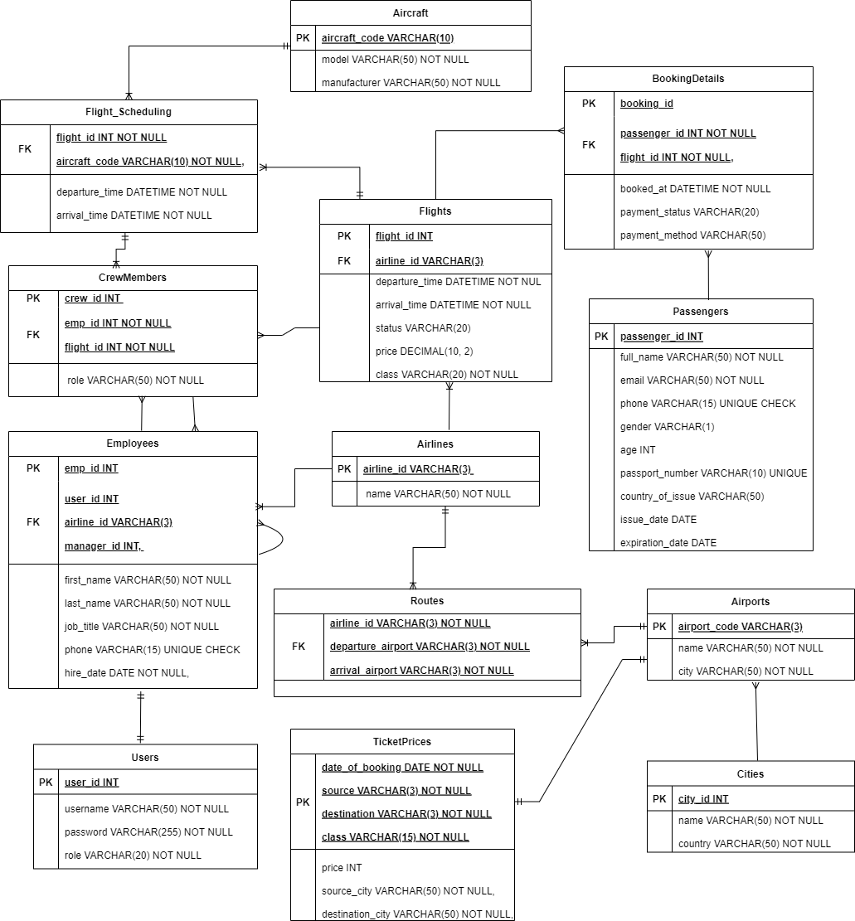
ER Diagram

Slide 5
Normalization Process “A crucial step in database design, ensuring data integrity and minimizing redundancy.“
1st Normal Form (1NF):
Ensured each table has a primary key for unique identification.
Eliminated repeating groups of data within individual columns.
Example: Passengers table with unique passenger_id and no repeating data.
2nd Normal Form (2NF):
Removed partial dependencies by ensuring all non-key attributes are fully functionally dependent on the primary key.
Example: Flights table, where attributes like departure_time and arrival_time depend on the full primary key, which includes flight_id and airline_id.
3rd Normal Form (3NF):
Eliminated transitive dependencies by ensuring that all non-key attributes are functionally dependent only on the primary key.
Example: Users table, where attributes like job_title and hire_date depend only on the primary key user_id.
Normalization enhances the database's structure, reduces redundancy, and ensures efficient data management.
Now that we have a well-organized foundation in place, let's examine the relationships between these entities.

Slide 6
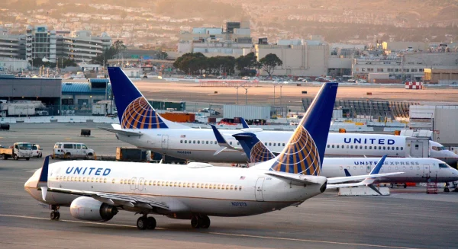
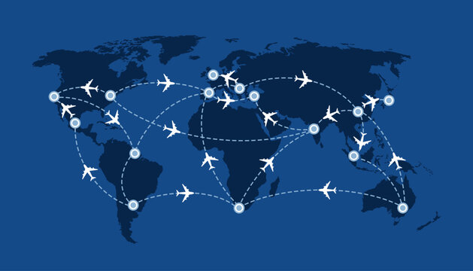
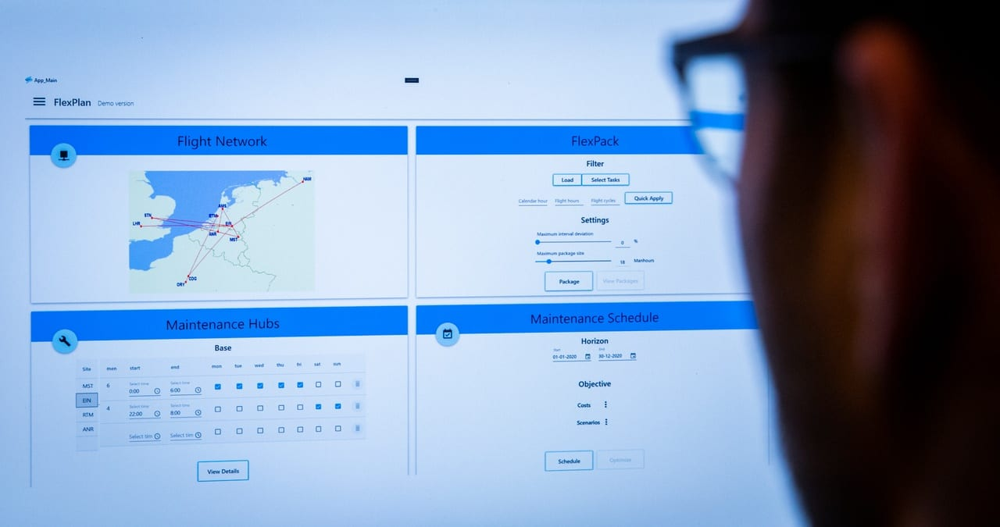
Entity Relationships "With our entities arranged, let's delve into the connections that link them, establishing the core of our database."
Airlines and Flights:
"Airlines and Flights share a one-to-many relationship.“
"Each airline can have multiple flights, but each flight belongs to only one airline.“
"Enforced through the airline_id foreign key in the Flights table.“
Flights and Routes:
One flight can operate on many routes.
One route can be served by many flights.
Relationship: Many to Many (a flight can operate on multiple routes, and a route can be served by multiple flights).
Flights and Flight_Scheduling:
"Flights and Flight_Scheduling share a one-to-one relationship.“
"Each flight has a corresponding entry in the Flight_Scheduling table, detailing departure and arrival times.“
"Ensured through the common flight_id key."
continue. . .

Slide 7
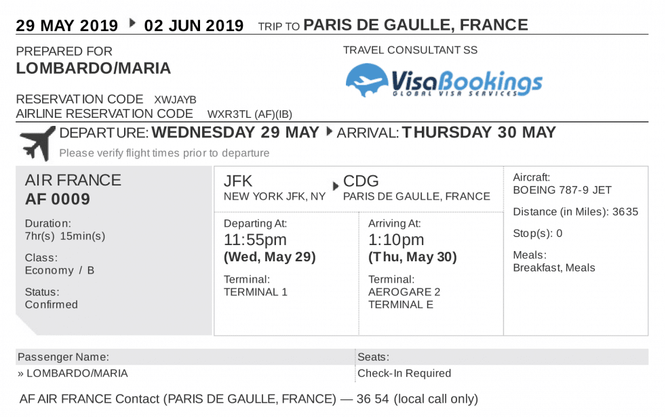


continue. . .
Passengers and Booking Details:
"Passengers and Booking Details are connected through a one-to-many relationship.“
"A passenger can make multiple bookings, but each booking is linked to one passenger.“
"Maintained by the passenger_id foreign key in the Booking Details table.“
Employees and Crew Members:
"Employees and Crew Members share a one-to-many relationship.“
"An employee can be part of multiple flight crews, but each crew member is associated with one employee.“
"Enforced through the emp_id foreign key in the Crew Members table.“
"These relationships ensure the interconnected flow of information, allowing us to navigate and manage the system effectively.“
Employees and Airlines:
"Employees and Airlines have a many-to-one relationship.“
"Many employees can work for one airline, but each employee is associated with only one airline.“
"Managed by the airline_id foreign key in the Employees table."

Slide 8
Database Constraints and Special Features Now, let's delve into the specific features and constraints that add robustness and reliability to our Airline Management System Database."
Primary Key Constraints:
"Every table includes a primary key, ensuring unique identification of each record.“
"Example: airline_id in Airlines table, flight_id in Flights table."
Foreign Key Constraints:
"Foreign keys establish relationships between tables, ensuring data consistency.“
"Example: airline_id in Flights, linking to airline_id in Airlines."
Unique Constraint:
"Used to enforce uniqueness within a column or a combination of columns.“
"Example: phone in Passengers and Employee table is unique.“
Check Constraint:
"Ensures that values inserted into a column meet specific conditions.“
"Example: Phone numbers in a specific format using a regular expression check."
Default Values:
"Certain columns are set with default values to ensure consistency and streamline data entry.“
"Example: Default values for payment_status in BookingDetails."
continue. . .

Slide 9
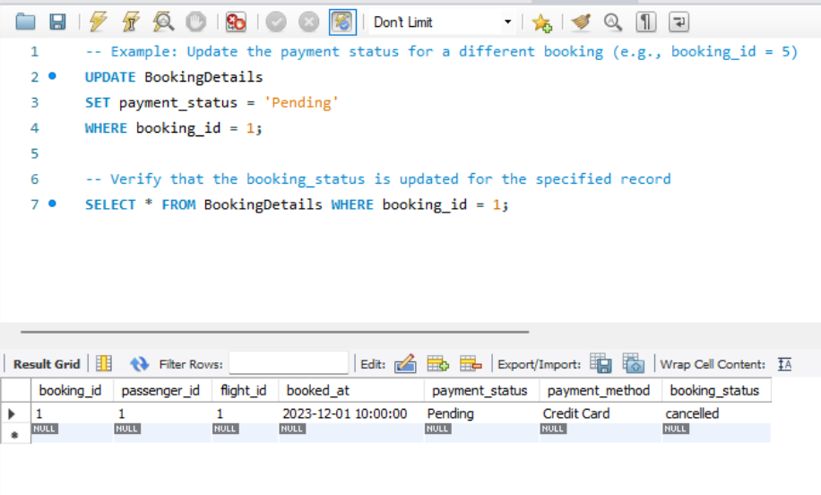
continue. . .
Triggers:
"Automated actions triggered by specific events.“
"Example: Trigger to update booking_status in BookingDetails after a certain event.“
-- Trigger to update booking status based on payment status
DELIMITER //
CREATE TRIGGER update_booking_status_update
BEFORE INSERT ON BookingDetails
FOR EACH ROW
BEGIN
IF NEW.paymentstatus = 'Paid’ THEN
SET NEW.booking_status = 'confirmed’;
ELSE
SET NEW.booking_status = 'cancelled';
END IF;
END;
//
DELIMITER ;

Slide 10
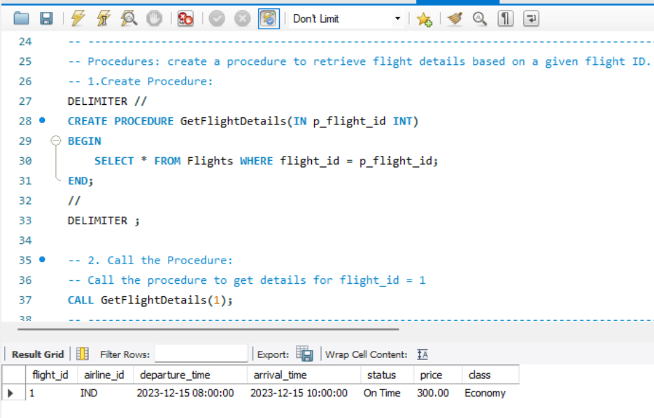
continue. . .
Stored Procedures (SP):
"Predefined SQL queries stored in the database for reuse and efficiency.“
"Example: A stored procedure for retrieving flight details based on flight ID“

Slide 11
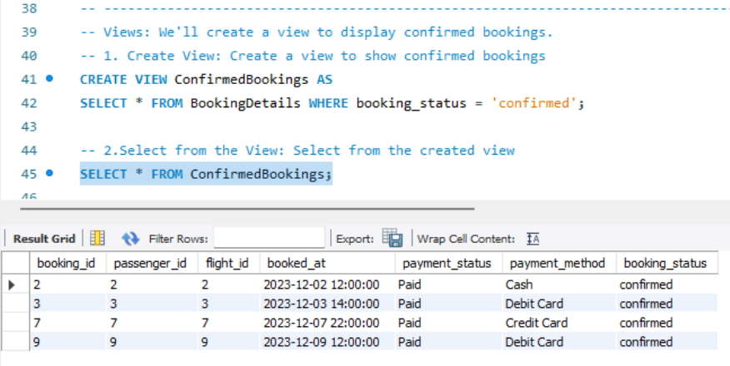
continue. . .
Views:
"Virtual tables representing the result of a SELECT query.“
"Example: A view summarizing information from multiple tables for easy access.“

Slide 12
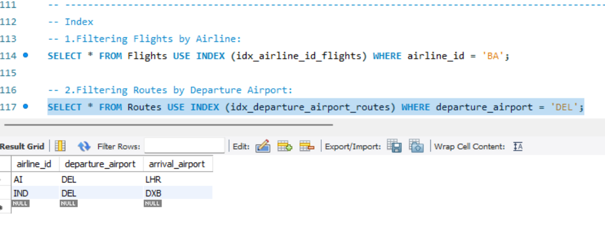
continue. . .
Indexes:
"Enhance query performance by providing quick access to rows in a table.“
"Example: Indexes on frequently queried columns like airline_id or flight_id.“
"These constraints and features collectively contribute to the integrity, security, and efficiency of our Airline Management System Database."

Slide 13

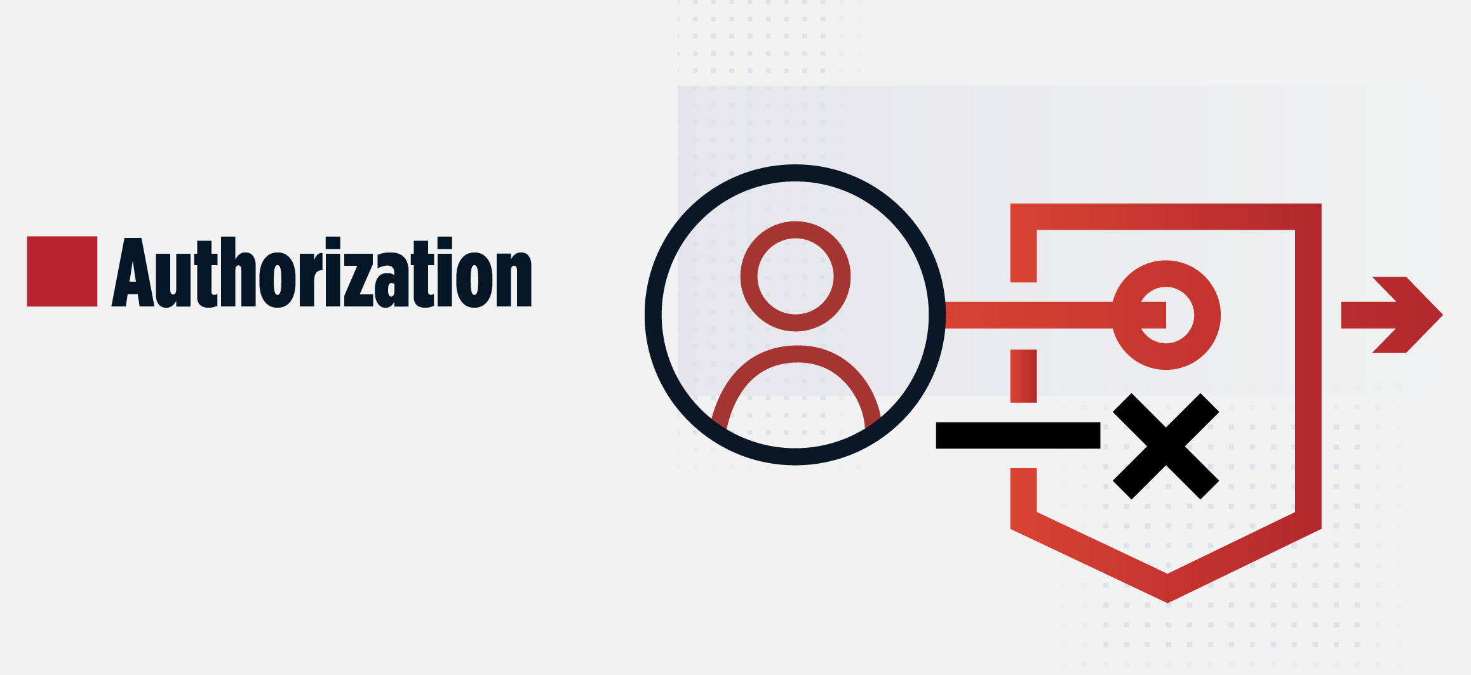

Authentication and Authorization "Security is paramount in our Airline Management System. Let's explore how authentication and authorization play crucial roles in safeguarding our database."
Authentication:
"Verifies the identity of users accessing the system.“
"Implemented through a secure login process with unique usernames and passwords.“
Authorization:
"Controls access to different parts of the database based on user roles and permissions.“
"Users are assigned specific roles, such as admin, staff, or passenger, determining their level of access.“
User Roles:
"Admins: Full access to all functionalities, including database modifications.“
"Staff: Limited access, focused on operational tasks and data management.“
"Passengers: Access to personal booking and flight information."

Slide 14
Analytical Queries
1] What is the total revenue generated by each travel class?
SELECT class, SUM(price) AS total_revenue
FROM Flights
WHERE status = 'On Time'
GROUP BY class;
2] How many passengers fall into each age group?
SELECT
CASE
WHEN age BETWEEN 1 AND 18 THEN '1-18'
WHEN age BETWEEN 19 AND 35 THEN '19-35'
WHEN age BETWEEN 36 AND 50 THEN '36-50'
WHEN age BETWEEN 51 AND 65 THEN '51-65'
ELSE '66+'
END AS age_group,
COUNT(*) AS total_passengers
FROM Passengers
GROUP BY age_group;
3] Which are the top 5 routes with the highest total revenue?
SELECT r.departure_airport, r.arrival_airport, SUM(f.price) AS total_revenue
FROM Routes r
JOIN Flights f ON r.airline_id = f.airline_id
WHERE f.status = 'On Time'
GROUP BY r.departure_airport, r.arrival_airport
ORDER BY total_revenue DESC
LIMIT 5;
4] What is the average booking amount for each payment method?
SELECT payment_method, AVG(price) AS avg_booking_amount
FROM BookingDetails b
JOIN Flights f ON b.flight_id = f.flight_id
WHERE f.status = 'On Time'
GROUP BY payment_method;

Slide 15


Conclusion
"In conclusion, our journey through the Airline Management System Database has been both insightful and enriching."
"We've covered the foundational aspects of entity organization, normalization, relationship structures, database constraints, and security measures."
Key Takeaways:
"Entities like Airlines, Flights, and Passengers form the core of our system.“
"Normalization ensures data efficiency and integrity.“
"Relationships interconnect entities, creating a cohesive system.“
"Database constraints and features enhance reliability and functionality.“
"Authentication and authorization fortify system security."
Looking Forward:
"As we move forward, the Airline Management System is poised to offer streamlined operations, efficient data management, and enhanced security."
"Continuous improvement and adaptation to evolving needs will remain a priority.“
"Thank you for joining this exploration of the Airline Management System Database. If there are any questions or further discussions, I'm here to address them."
"Safe travels through the world of data management and airline operations!"

Slide 16


Slide 17
Prof. Ozbek YUSUF
Guidelines:
I will start by explaining the topic. Why did I choose this topic.
I would then show the list of the Entities
Then I would show the ER diagrams
Then, I would explain how I normalized it
Then talk about the Relationship between the entities
Then talk about constraints, and other DB specific stuff
I would talk about some other stuff that was done Like, SP, Views, Triggers, UDF, etc.
I would discuss my Authentication and Authorization
I would show some analytic queries if I had it to impress the professor
Conclusion

